Slide 1
Presentation for
3D Reconstruction and Modelling of Roofs in European Cities
Berk Kıvılcım
berk.kivilcim24@gmail.com

Slide 2
Content
1 - Introduction
2 – Algorithm
Find planar triangles
Find footprint triangles
The Main Principles of Algorithm
Building footprint creation
Filter the non-footprint vertices
Building height detection rooftop creation
Identify the requirements for LoD 1.2
Derive building heights satisfy the conditions
Rooftop triangulation
Building sidewall creation
Rectangle generation
Create triangles from the rectangles
Merge all footprint + rooftop + footprint
Final Result Preview

Slide 3

INTRODUCTION

Slide 4
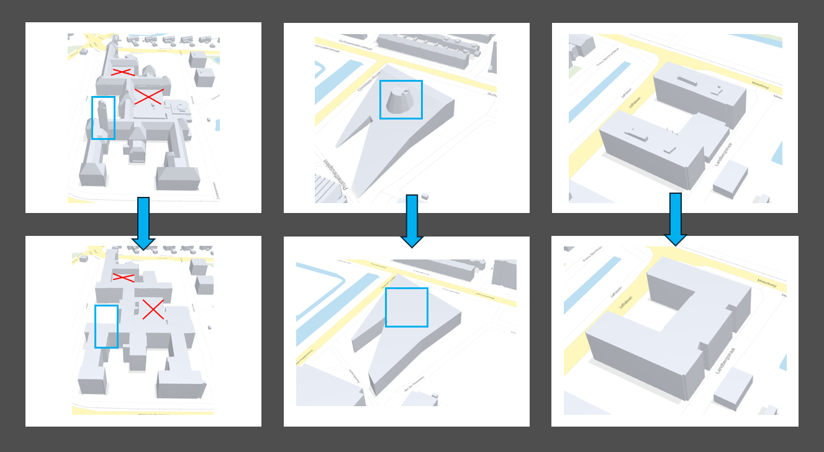
The Task
Convert LoD 2.2 to LoD 1.2

Slide 5
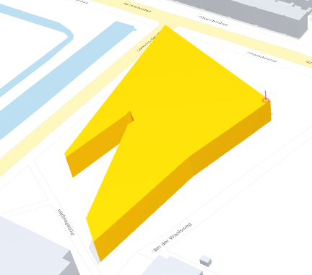
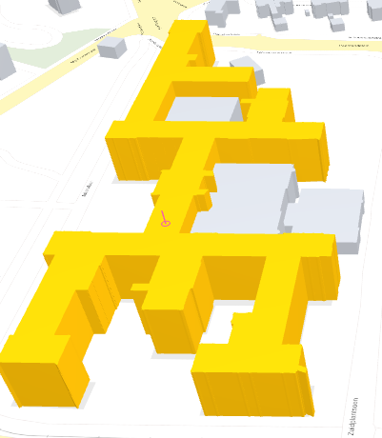
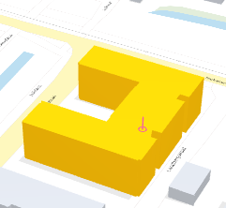
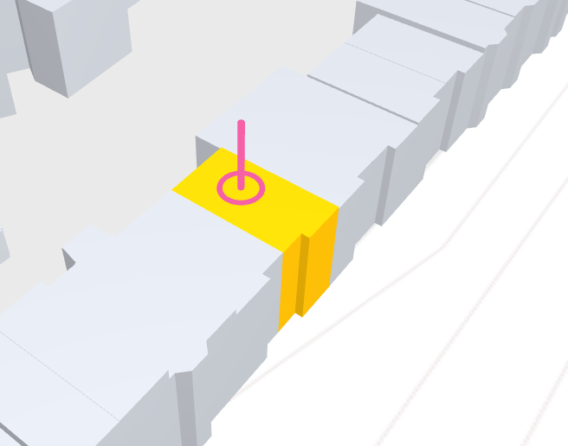
The Final Result Preview
Height Comparisons:
 | My Calculated Height Results | Height Values from 3dbag.nl
beeb.obj | 12.0 meter | 13.4 meter
bk.obj | 24.03 meter | 21.5 meter
otb.obj | 19.93 meter | 18.3 meter
simple.obj | 9.7 meter | 8.7 meter
Beeb.obj
bk.obj
otb.obj
simple.obj

Slide 6
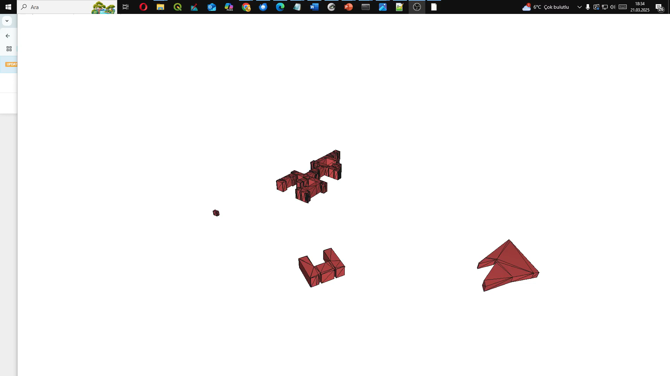
The Final Result Preview
A video demonstrate the final result:

Slide 7
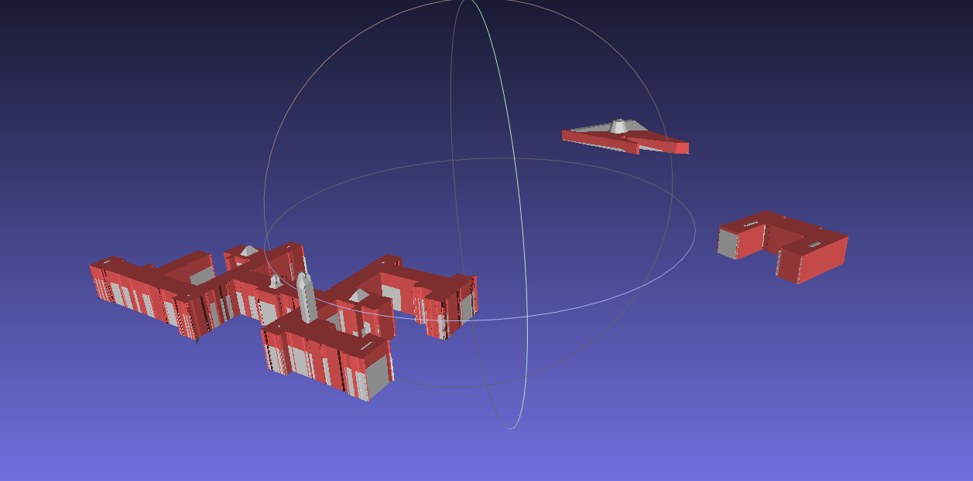
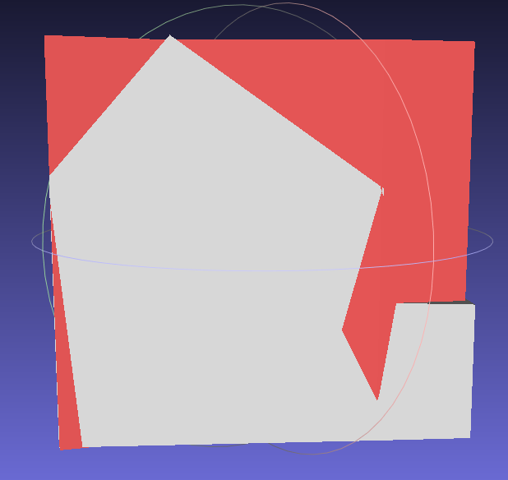
Final Results Visualization Overlapped with Original Data:

Slide 8
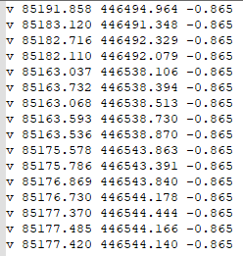
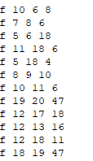
The Data
Triangles
Vertices (Points) has XYZ values
Absolute Values
Faces (3 point indices represent one triangle face)
Topological relations

Slide 9
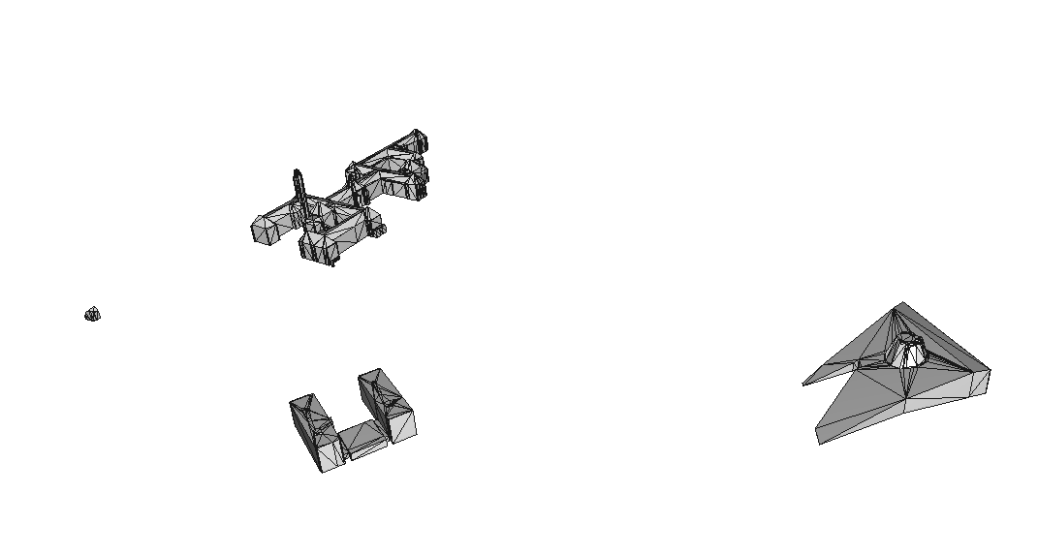
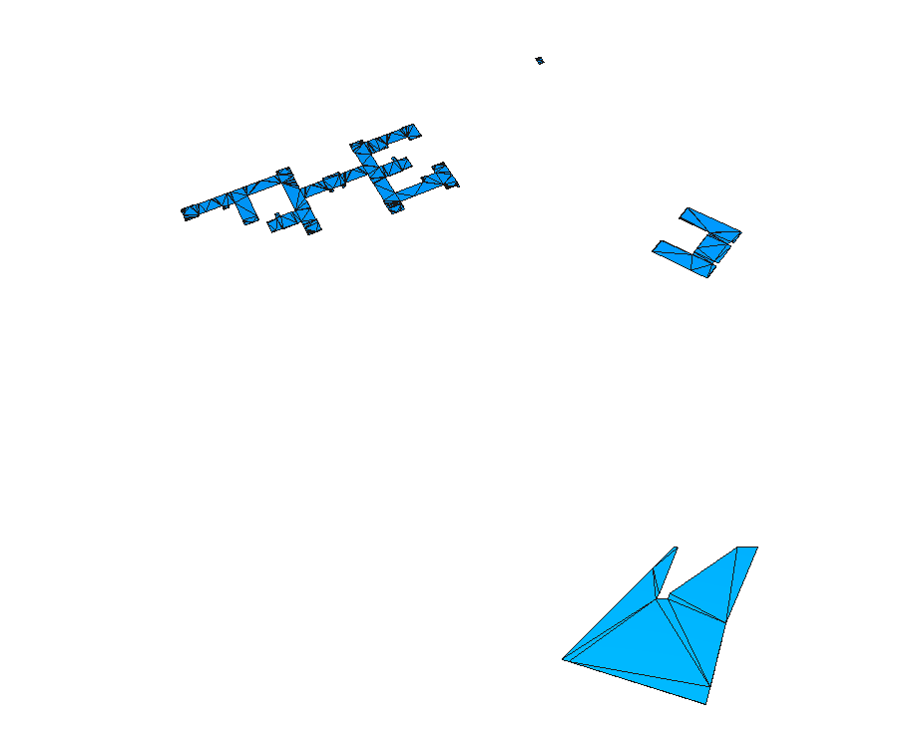
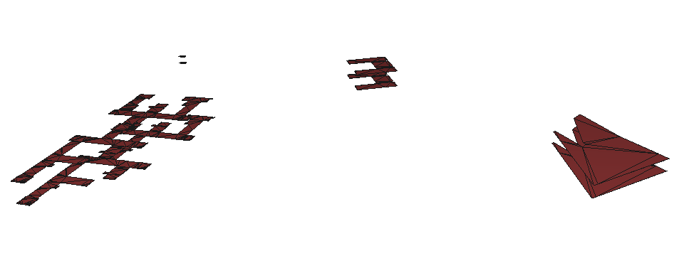
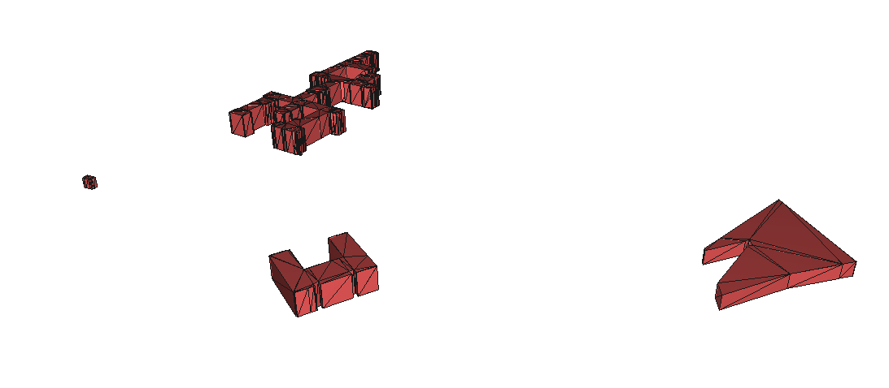
The Main Idea
Find the building footprints
Find the proper building heights
Construct rooftops according to building height and footprint
Construct walls according to footprints and rooftops
The original LoD 2.2 Data (top view)
The footprint (bottom view)
The footprint and rooftop (bottom view and orientation of rooftop not fixed)
Final Results with walls and proper face orientations (top view)

Slide 10
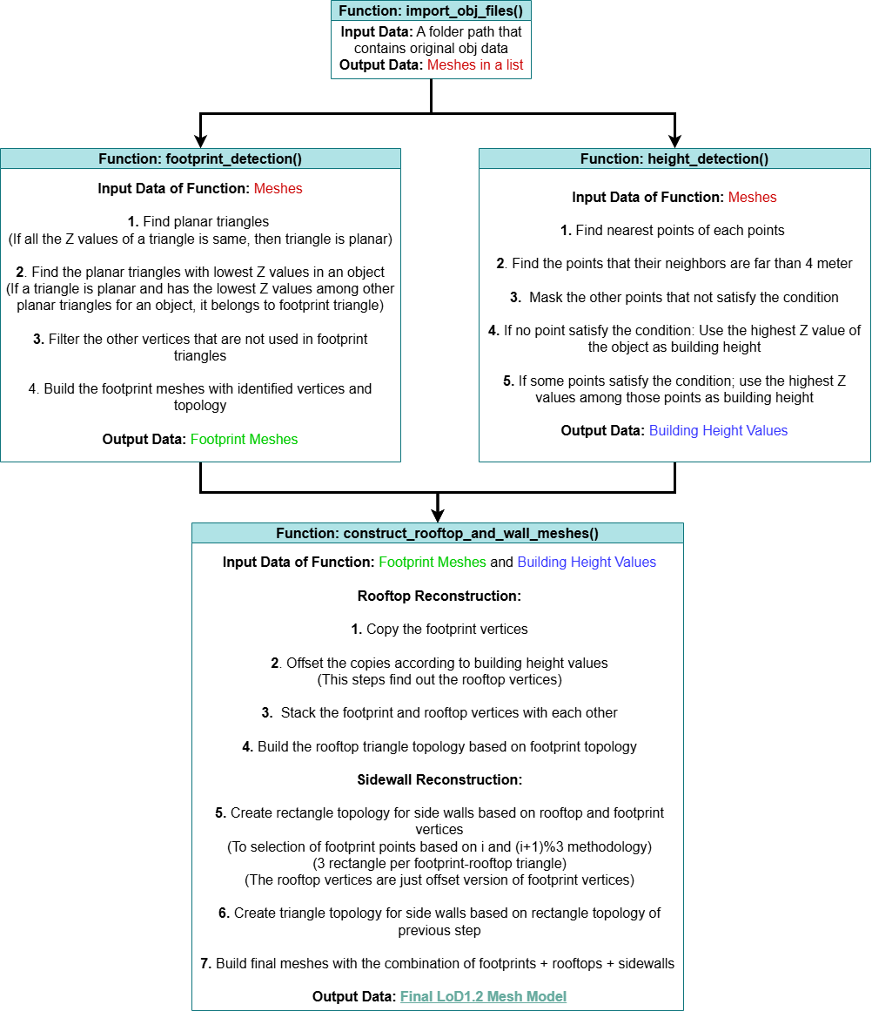
Workflow

Slide 11
ALGORITHM

Slide 12
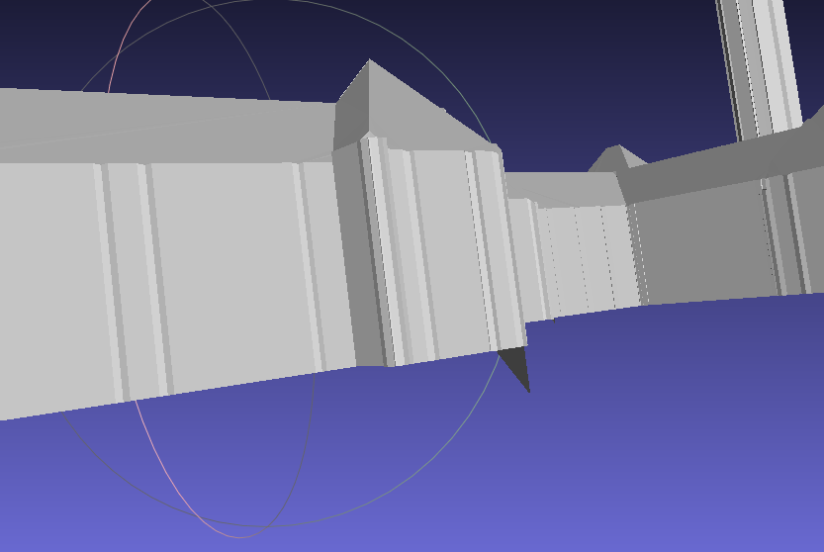
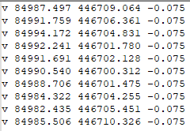
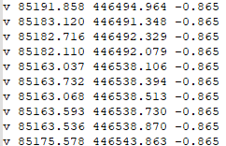
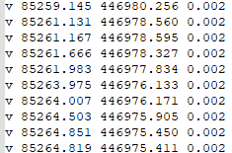
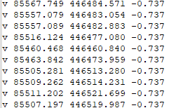
Finding Building Footprints
Assumptions:
Is lowest Z values belongs to footprints?
NO
Is footprint triangles are planar?
Yes
Some data from different buildings

Slide 13
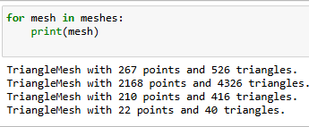
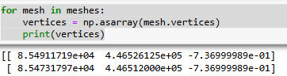
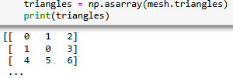
Finding Building Footprints
Algorithm:
Load all of the Mesh models at once from a folder
Process all mesh models one by one
Store the XYZ values of vertices and topology of triangles in lists

Slide 14
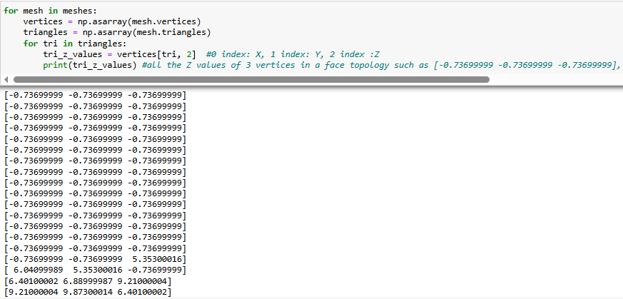
Finding Building Footprints
Algorithm:
Store all the Z values of a triangle
The array size is (Number of triangle x 3) because each triangle has 3 point
Vertices[tri, 2] means vertices indexes extracted from triangles array and 2 means Z values of the vertices since Python indexing starts from 0.

Slide 15
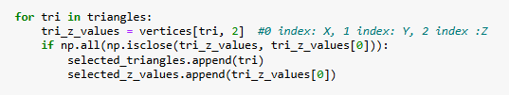
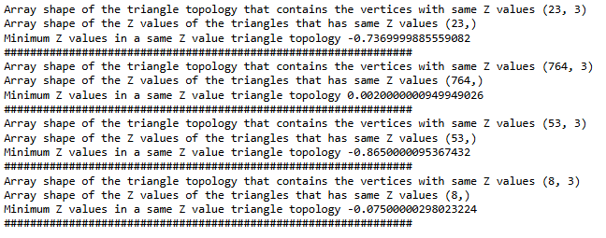
Finding Building Footprints
Algorithm:
If the first Z value of a triangle and rest of the Z values in the same triangle is same (Planarity condition)
Then a new triangle array and corresponding Z value arrays are created
For example, for the first object, 23 triangle satisfy the planarity

Slide 16
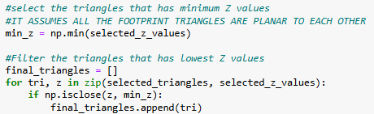
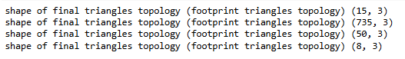
Finding Building Footprints
Algorithm:
But are all planar triangles belongs to footprint?
No
Assumption 1:
All the footprint triangles are planar to each other
Also has the lowest Z values among the other planar triangles
For example, for the first object, 15 triangle satisfy the planarity and having the lowest Z values

Slide 17
Finding Building Footprints
Algorithm:
So the variables of ‘’final_triangles’’ store the triangle topologies of footprints
Footprint triangle mesh model creation
But how about the vertices belongs to only footprints?
Filters the points that is not used in final_triangle topology
A figure to show for unreferenced vertices filtering
All vertices from original data

Slide 18
Finding Building Footprints
Results:
Triangle Topology for Footprints:
Vertices for Footprints:
Building Footprint Triangulation (Bottom View)

Slide 19
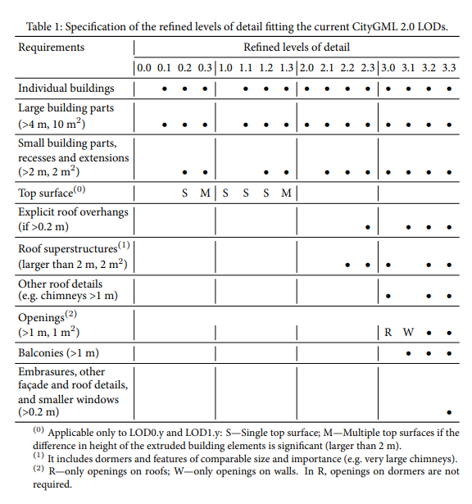
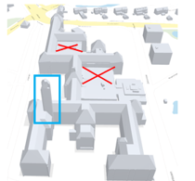
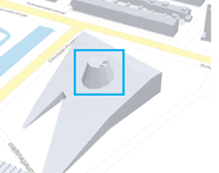
Finding Proper Building Heights
Algorithm:
LoD1 models usually derived from bounding Box of LoD2 (Diakite et al 2014, El-Mekawy et al, 2011)
So is it sufficient to consider highest height value for a bounding box??
No
Those details considered as large building parts
The additional condition: If a point has neighborhood point closer than 4 meter, don not consider its height as building height

Slide 20
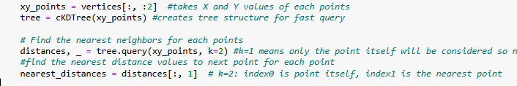
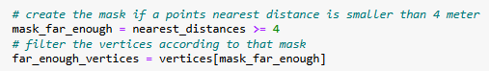
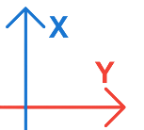
Finding Proper Building Heights
Algorithm:
Find the nearest distances of each point
Create a mask if a nearest distance is smaller than 4 meter
Then apply the mask to exclude this points
If a point satisfy the above condition:
The highest Z value among the those points will be considered building height
If none of the point satisfy the above condition
The highest Z value in the object will be considered as building height
Z=10 m
Z=20 m
>4m
<4m
A figure to show how nearest neighbor thresholding works

Slide 21
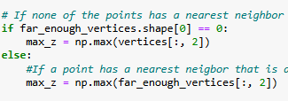
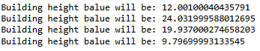
Finding Proper Building Heights
Algorithm:
If a point satisfy the condition given in previous slide:
The highest Z value among the those points will be considered building height
If none of the point satisfy the above condition:
The highest Z value in the object will be considered as building height
Calculated height results:

Slide 22
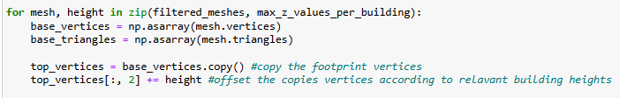
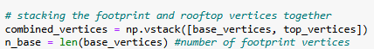
Creating Rooftops Triangulations
Algorithm:
Uses footprint triangulations and calculated building height values
Rooftop Vertice Creation:
Copy the identifies footprint vertices of the objects
Add calculated height values to Z values of those copied vertices
Stack footprint and rooftop vertices with eachother.
Rooftop indices follow the footprint indices, as unused vertices were removed during footprint filtering in previous steps

Slide 23
Creating Rooftops Triangulations
Algorithm:
Rooftop Triangulation Topology Creation:
The triangulation of the rooftops are invert oriented for proper visualization
Since the rooftop indexes are continuation of footprint indices ‘‘+n_base’’ is used

Slide 24
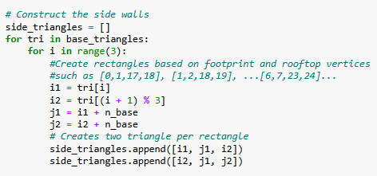
Creating Sidewall Triangulations
Algorithm:
Side Wall Triangulation Topology Creation:
First create rectangles based on footprint and rooftop vertices
Example indices: [0,1,17,18], [1,2,18,19], ….
3 rectangle per footprint-rooftop triangle
Using (i) and (i+1) %3 to prevent the confusion between rectangles with a proper triangle structuring
For example;
if i=0 then (i+1)%3 =1
if i=1 then (i+1)%3 =2
if i=2 then (i+1)%3 = 0 (return back to 0 and close the triangle)
19
18
17
2
1
0

Slide 25
Creating Sidewall Triangulations
Algorithm:
Side Wall Triangulation Topology Creation:
Create two triangle from that rectangle
j1
j2
i1
i2

Slide 26
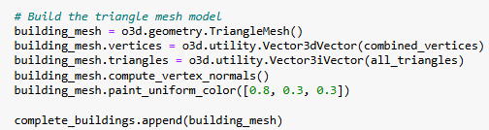
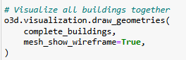
Creating Sidewall Triangulations
Algorithm:
Final Modelling:
Stack all footprints, rooftops and side walls topologies
Create the mesh structure
Visualization:

Slide 27
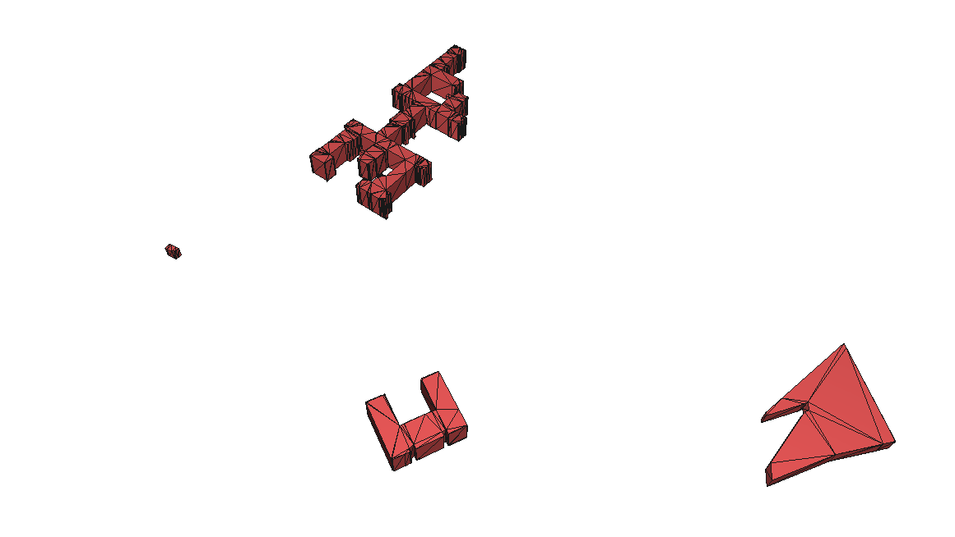
Final Result Visualization:

Slide 28


Slide 29
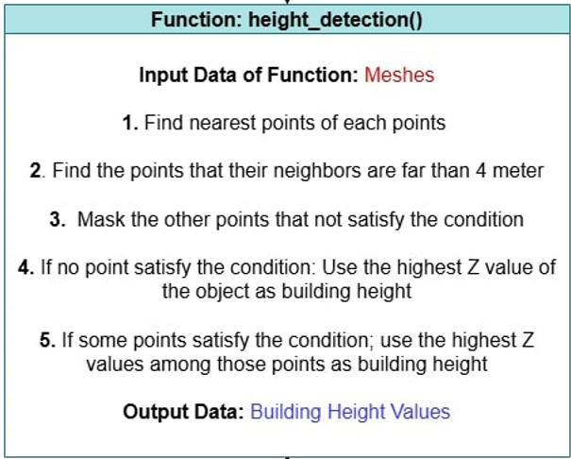
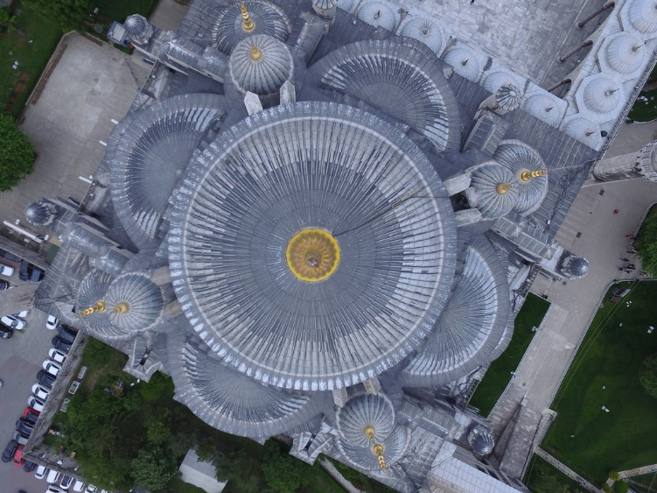
What could be done better
More precise height detection

Slide 30
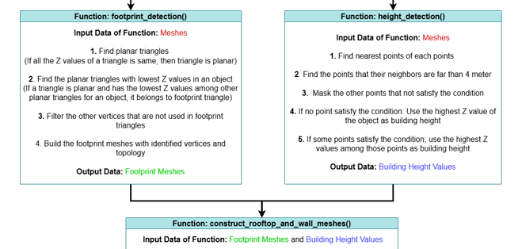
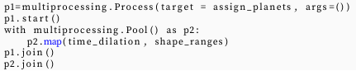
What could be done better
Parallel Computing for fast Implementation
Simultaneously execute the independent functions (Easier)
An example from my first lab rotation

Slide 31
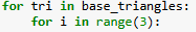
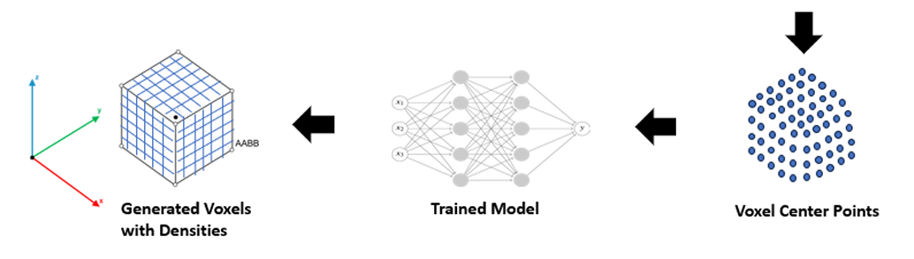
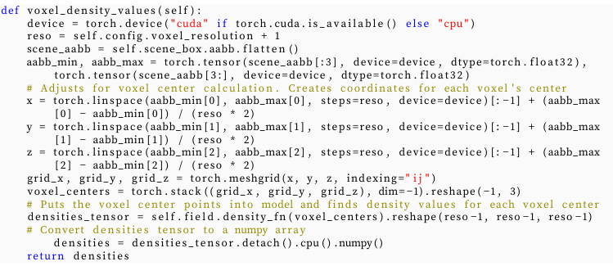
What could be done better
Parallel Computing for fast Implementation
Simultaneously execute the ‘‘for loops’’ for independent operations (More complex)
An example from my master thesis
19
18
17
2
1
0

